Slide 2
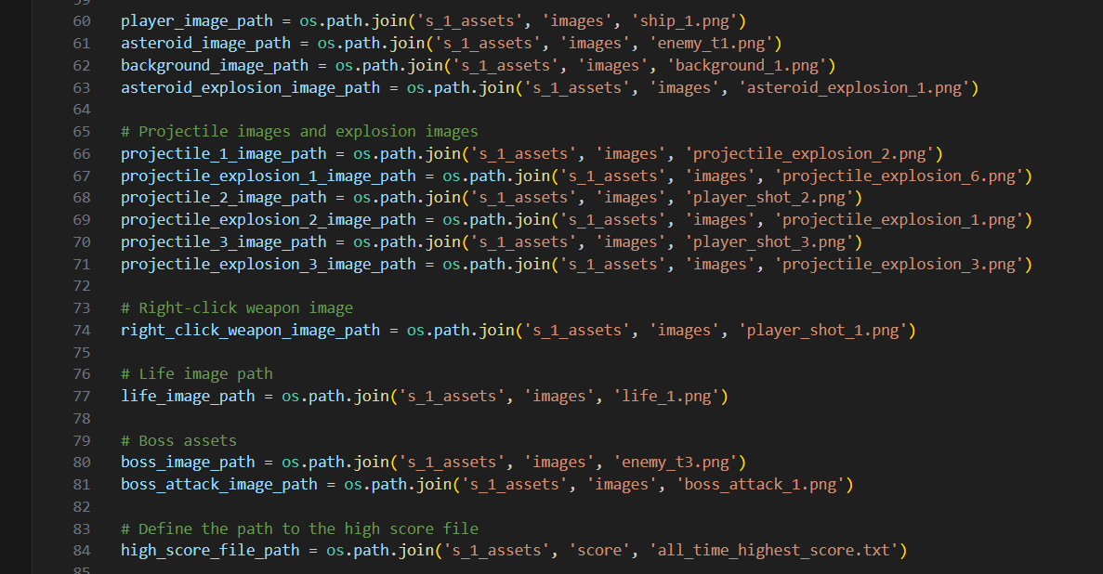
PATHS - Assets

Slide 3
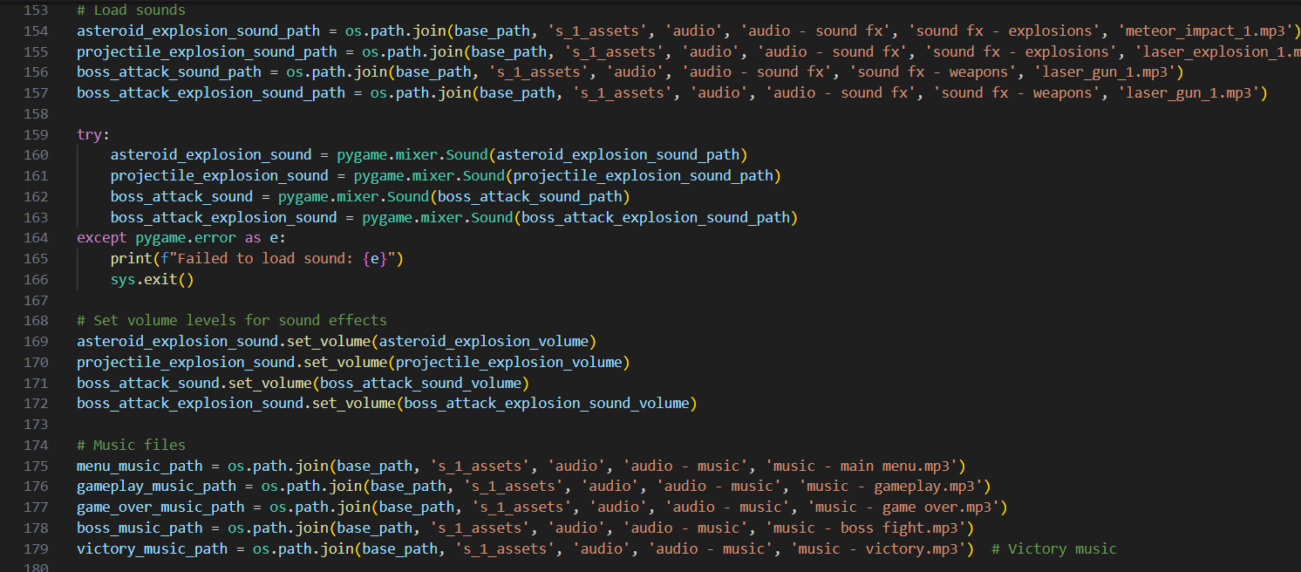
PATHS - Audio

Slide 4
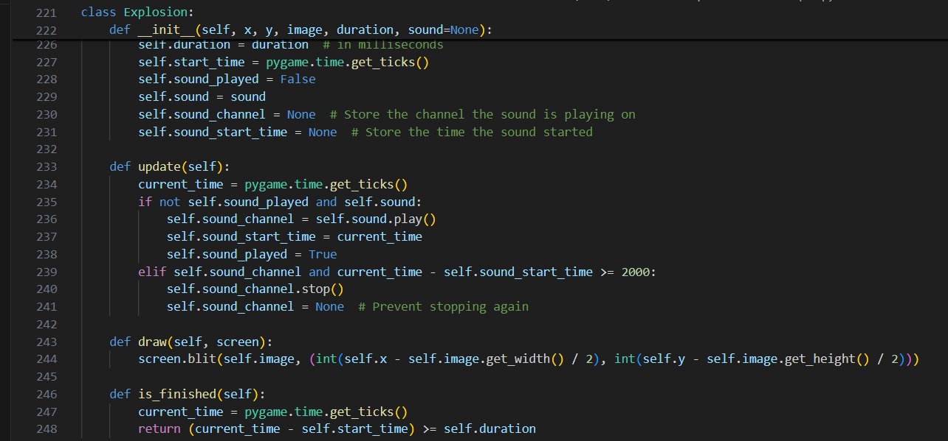
CLASSES - Explosions

Slide 5
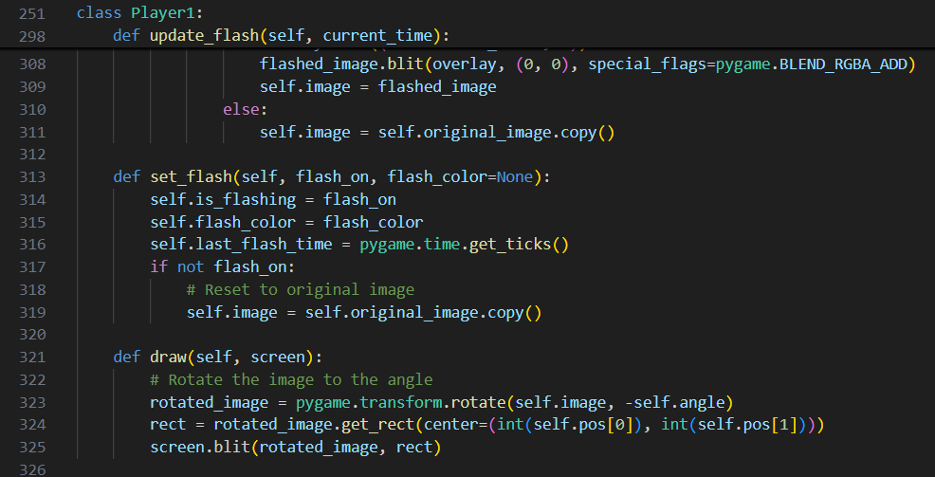
CLASSES - Player

Slide 6
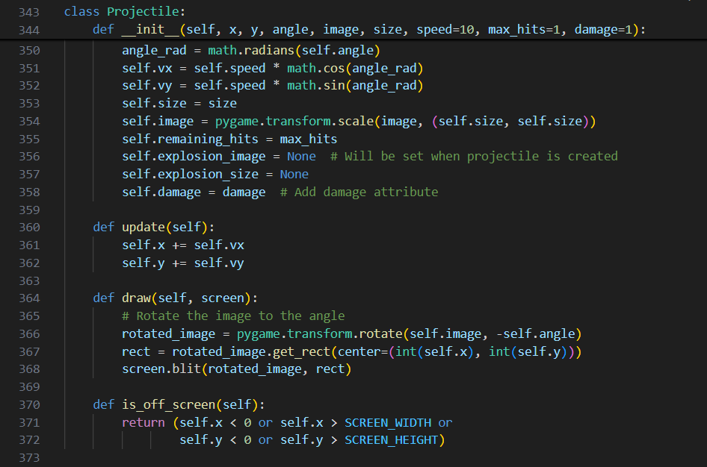
CLASSES - Projectile (player attacks)

Slide 7
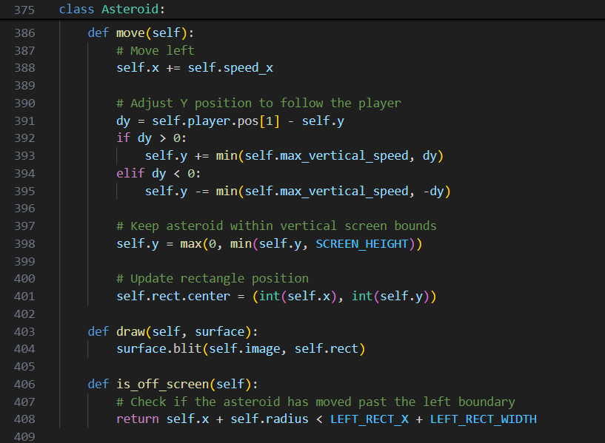
CLASSES - Asteroid (enemies)

Slide 8
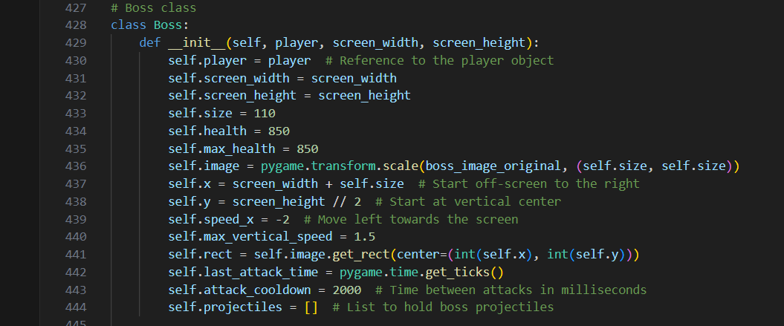
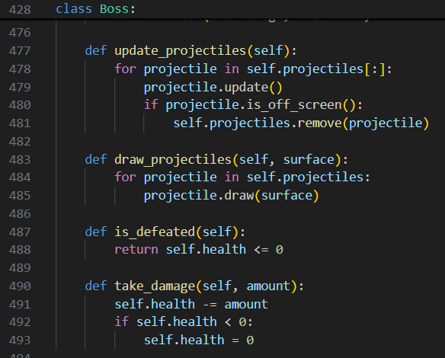
CLASSES - Boss

Slide 9
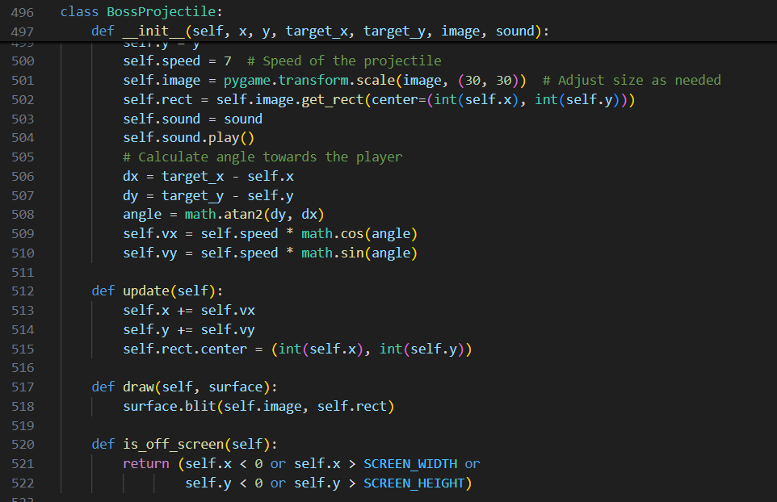
CLASSES - Boss’ Projectile

Slide 10
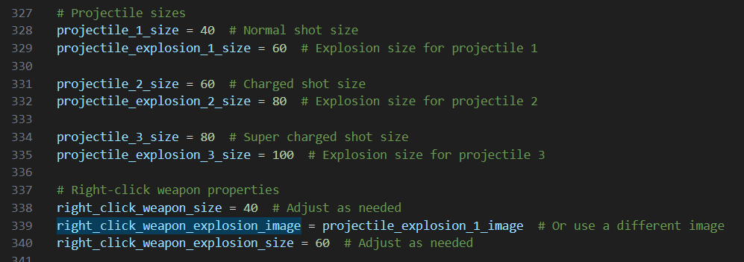
CLASSES - Projectile sizes

Slide 11
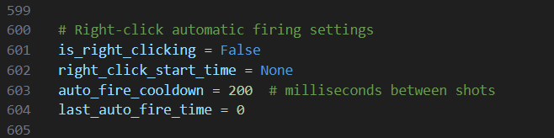
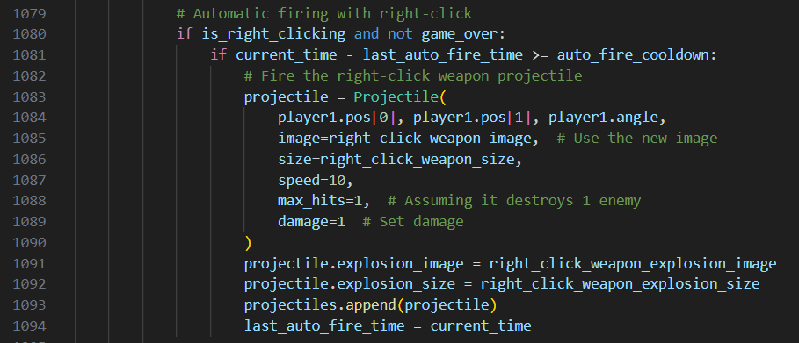
Player - Weapons - full-auto fire rate (HOLD RIGHT CLICK)

Slide 12
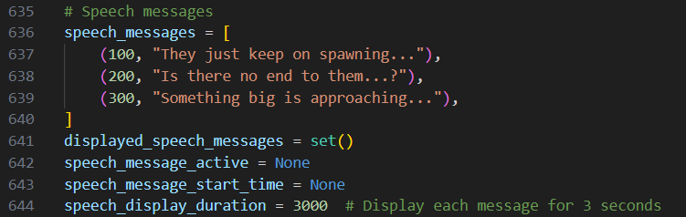
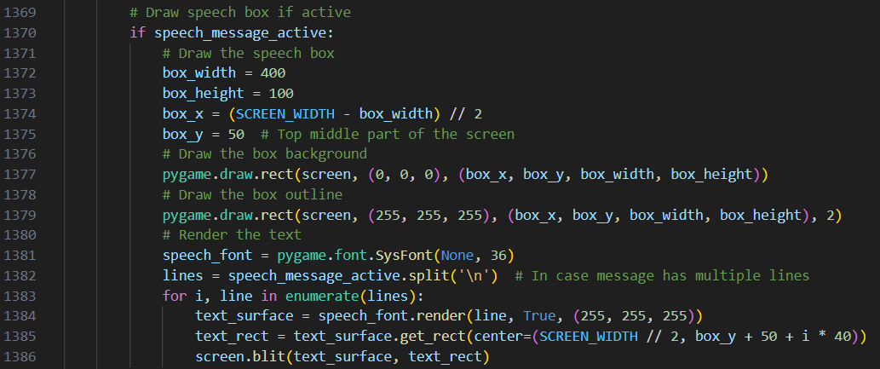
Dialogue box

Slide 13
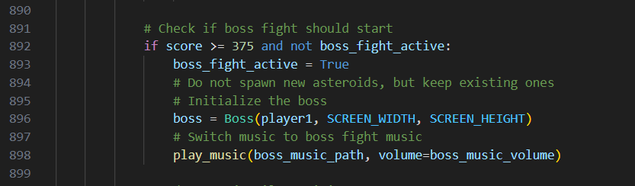
Boss Fight Trigger -
Number of enemies killed before boss appears

